Slide 1


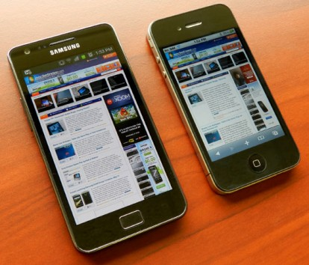
Prototype Major Functional Component Diagram
Trending
Algorithms
Web App
Server
DB
GTFS
Simulated GPS Data
Simulated APC Data

